Slide 1
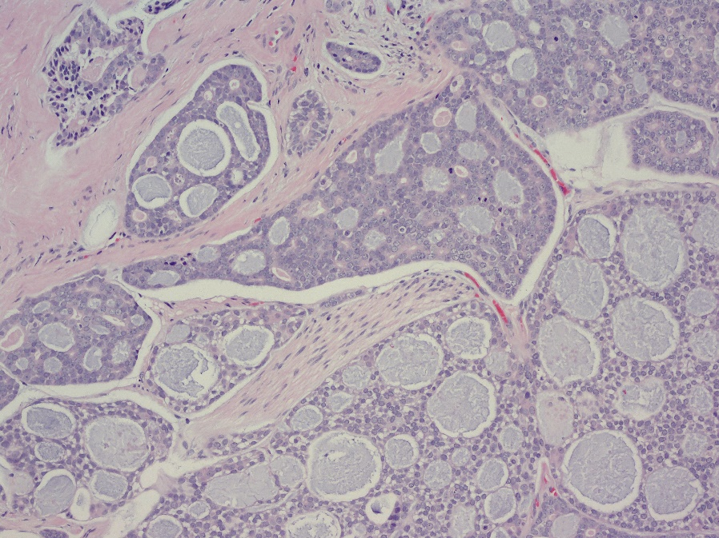
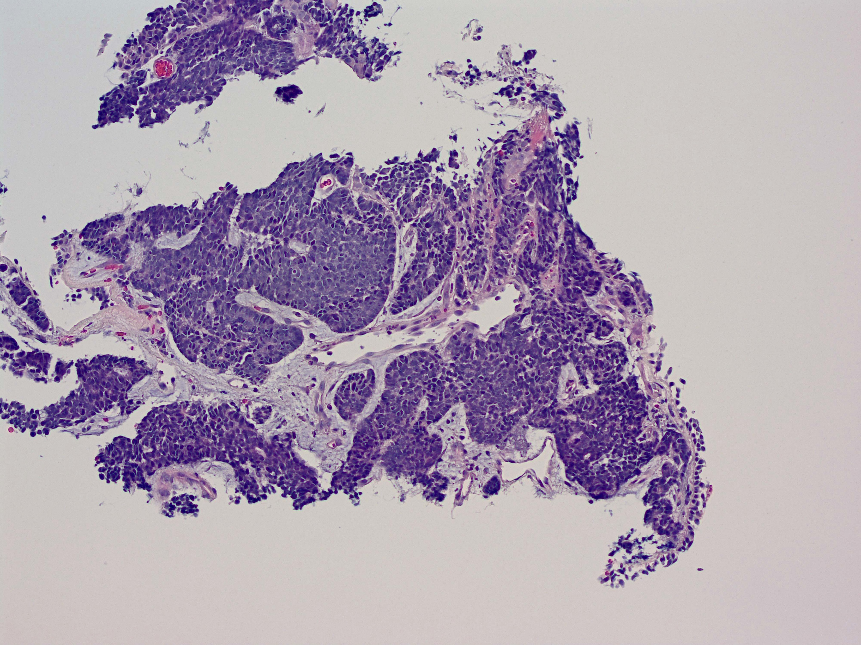
Characterisation of treatment and outcomes for adenoid cystic carcinoma as a distinct clinical sub-type of triple negative breast cancer
Fiona Britton¹, Steven Churchill¹, Paul Bishop², Guy Betts², Joseph Haigh¹, Emily Heathcote¹, Anne Armstrong¹, Robert Metcalf¹
Poster ID SESS-2231, P2-11-21
Background
Results
Discussion
Adenoid cystic carcinoma (ACC) most commonly arises within the salivary glands but can also occur in other glandular tissue including the breast.
ACC of the breast (ACCB) represents c.0.1% of breast cancer diagnoses¹ and typically has triple negative receptor status.
ACC is a slow growing disease with high rates of recurrence many years after diagnosis².
ACC has very low response rates to cytotoxic chemotherapy³.
Table 1. Summary of baseline clinical characteristics and curative-intent management for 16 patients with AACB
ACCB patients received treatment for early breast cancer which was consistent with management for invasive ductal/lobular carcinoma, combining surgery with anthracycline and taxane-based adjuvant chemotherapy and accompanied by adjuvant radiotherapy.
Median time to recurrence was 74 months, with the earliest recurrence at 27 months.
Treatment of metastatic disease with systemic anti-cancer therapies (SACT) lead to either stable disease or progression on 1st on-treatment imaging.
In ACCB patients treated with SACT, median OS from recurrence was 10months which was equivalent to patients who had resection of oligometastatic disease, or best supportive care.
Whilst OS is equivalent in the ACCB group when compared to the whole ACC cohort, survival from recurrence is significantly shorter.
It remains unclear whether SACT in the metastatic setting provides any survival benefit for ACCB patients.
Tumour stage | No of ACCB patients | Surgery | No of ACCB patients
T1 | 7 | Breast conserving | 10
T2 | 6 | Mastectomy | 6
T3 | 3 | Sentinel lymph node biopsy | 13
N0 | 12 | Axillary lymph node clearance | 3
N1 | 2 | Adjuvant chemotherapy
Nx | 2 | Yes | 6
Tumour grade |  | No | 8
1 | 0 | Adjuvant radiotherapy
2 | 6 | Yes | 11
3 | 4 | No | 4
Aims
Describe the clinical course of the disease for ACCB
Compare survival outcomes between ACCB and the whole ACC cohort
Of the 16 patients included in the ACCB cohort, receptor status was available for 15.
14 patients were ER0, PR0 and HER2 negative. One patient was ER8, PR5 HER2 1+; they received adjuvant endocrine therapy and have had no recurrence 13 years after treatment.
Methods
Retrospective review of 450 patients diagnosed with ACC between 1980 and 2022, including 16 patients with ACCB
July ‘18;
metastatic disease
March – May ’19;
PlasmaMATCH E - 2 cycles
(Olaparib + AZD 6738)
Sept 2020;
died
Best supportive care
A
Summary of clinical and pathological characteristics from electronic records
A
Aug ‘18 – March ’19;
IMPASSION 131 - 6 cycles
(Paclitaxel + atezolizumab vs placebo)
May – Aug ’19;
Capecitabine - 4 cycles
Take home messages
ACCB is a rare breast cancer subtype and follows a different clinical course to IDC/ILC
Better treatments are needed to treat ACCB patients
Description of curative-intent management and treatment of metastatic disease in ACCB patients
Aug ‘19;
metastatic disease
Time from diagnosis (months)
Best supportive care
B
Figure 3A. Kaplan-Meier curve showing equivalent overall survival (OS) for the whole ACC cohort and the ACCB group (mOS 10.2 years).
3B. Kaplan-Meier curve showing significantly shorter survival from recurrence in the ACCB patients compared to other ACC patients. Median time to recurrence for ACCB patients was 74 months, while mOS from recurrence was 0.83 years compared to 4.25 years in the whole ACC cohort, p<0.0001.
B
Aug – Oct ’19;
Capecitabine – 3 cycles
March 2020;
died
Comparison of survival outcomes for ACCB patients to the whole ACC cohort
Figure 1A. Low grade adenoid cystic carcinoma with cribriform nests of tumour.
B. High adenoid cystic carcinoma with solid nests of basaloid cells and only very focal tubular structures
Next steps
Figure 2. Timeline and description of metastatic treatment for 2 patients who received systemic anti-cancer therapy for metastatic ACCB.
RNAseq/proteomic analysis of ACCB compared to stage and grade matched ACC of the parotid
Contact
Author affiliations
¹The Christie NHS Foundation Trust, Manchester, UK, ²Manchester University NHS Foundation Trust, United Kingdom
References
Dr Fiona Britton, Medical Oncology Registrar
The Christie NHS Foundation Trust
Email: Fiona.britton1@nhs.net
Glazebrook et al. AJR 2010 May;194(5):1391-6. Adenoid cystic carcinoma of the breast
Ellington CL et al. Cancer 2012;118(18):4444–51. Adenoid cystic carcinoma of the head and neck: Incidence and survival trends based on 1973–2007 Surveillance, Epidemiology, and End Results data.
Laurie, S.A et al. Lancet Oncol. 2011, 12, 815–824. Systemic therapy in the management of metastatic or locally recurrent adenoid cystic carcinoma of the salivary glands: A systematic review.
This presentation is the intellectual property of the author/presenter. Contact them at fiona.britton1@nhs.net for permission to reprint and/or distribute.

