Slide 1

ACCRF Research Update
Jeff Kaufman, Executive Director
Notes:
Remember to emphasize that research is focused on patients with advanced or recurrent disease that isn’t curable.
About half of patients don’t get metastases and have a chance at a cure, don’t need to stress out about. We just don’t know exactly which half of patients they are.
Also, mention that genetic alterations I will mention do not mean ACC is inheritable.

Slide 2
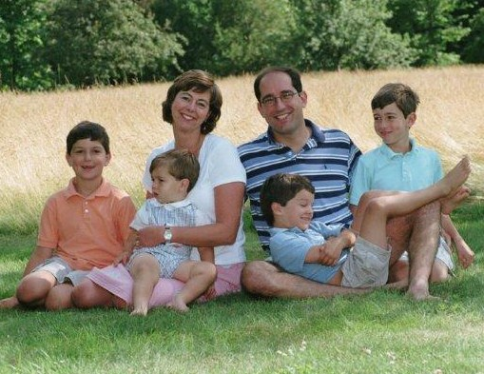
The Roots of ACCRF
ACCRF is a public charity established in December 2005 in Needham, Massachusetts, USA
ACCRF was founded by Marnie and Jeff Kaufman. Marnie was diagnosed with ACC at 38 years old when she had four boys under the age of 10.

Slide 3
ACCRF Overview
MISSION
GOAL
STRATEGY
Accelerate the development of
better treatments
and a cure
for ACC patients
Develop a
pipeline of
clinical trials
based on the best available science
Create a community
of researchers
following a coordinated plan that is driven by supportive and supported patients

Slide 4
ACCRF Research Network
Patients
Academic Institutions
ACCRF
Encourages collaborations
Provides Grants
Hosts scientific meetings
Manages PDX platform
Engages Biopharma
and Government
Private Industry
MD Anderson
University of Virginia
Gothenburg University (Sweden)
University of Melbourne (Australia)
University of Munster (Germany)
Seoul National University (Korea)
Radboud University (Netherlands)
University of Manchester (UK)
Massachusetts General Hospital
Memorial Sloan-Kettering
Johns Hopkins
Dana-Farber Cancer Institute
University of New Mexico
Massachusetts Institute of Technology
Yale University
South Texas Accelerated
Research Therapeutics (START)
Bethyl Labs
Cell Signaling Technology
Novartis
Pfizer
Eli Lilly
Merck
Bristol-Myers Squibb
Abbott
Bayer
Astra Zeneca
Glaxo Smith Kline
Ayala
Syndax
Government
National Institute of Dental and
Craniofacial Research (NIDCR)
National Cancer Institute (NCI)

Slide 5
ACCRF Research Agenda
ACC Patient Community
Donation of Specimens
& Medical Records
Funding
Input on Key Challenges
& Unmet Needs
Clinical Trial Enrollment
ACC Research Community
Building Blocks of Research
What can researchers work with to find answers?
• Biorepository & Registry
• Cell Lines
• Mouse Models
Mechanisms of Action
What biological processes make ACC possible?
• Genomics
• Pathway Identification
• Target Validation
Translational Research
What will hit the Achilles’ heels of ACC?
• Functional Studies
• Drug Discovery
• Preclinical Screening
Clinical Research
What will work in actual patients?
• Approved Drugs
• Novel Drugs
• Radiation/Radiology
Better Therapies and Outcomes for Patients

Slide 6
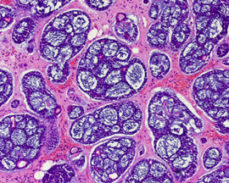
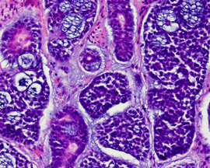
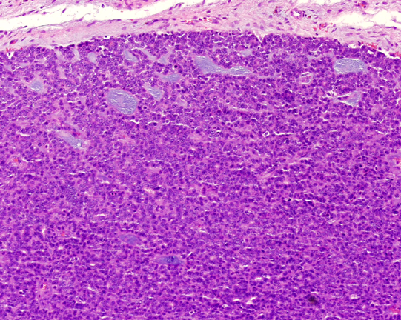
How We Think ACC Works
Szanto et al., Cancer (1984)
Grade 1
No solid component
Grade 2
<30% solid
Grade 3
>30% solid
MYB or MYBL1 fusion and overexpression
Mutations in NOTCH1, FGFR, PI3K
and chromatin modifiers
Sufficient to start tumors
and for slow growth
Secondary drivers of
more aggressive growth

Slide 7
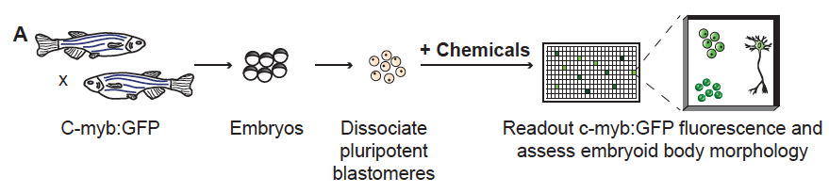

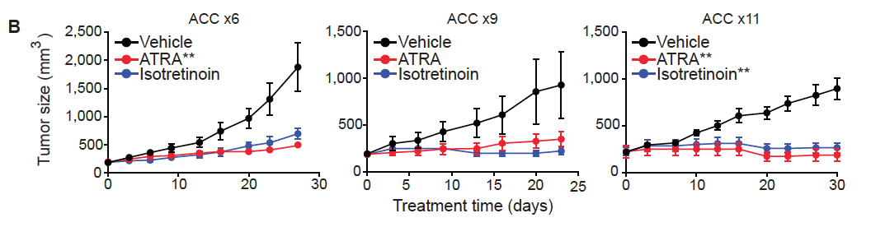

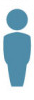
ACCRF Support: Lab to Clinic
ACCRF grant to screen for MYB inhibitors
ATRA inhibits tumor growth in ACC models
ACCRF co-funds
ATRA clinical trial
(currently recruiting)

Slide 8


TARGETING NOTCH IN ACC
Rationale: Approximately 25% of recurrent/ metastatic ACC patients have activating NOTCH mutations, a marker of more aggressive disease
AL101 (GSI) Phase II trial is open to ACC patients with activating mutations in NOTCH 1, 2, 3 or 4. Sites open in Denmark, France, Spain, UK and USA.
CB-103 (pan NOTCH inhibitor) Phase I trial is open to patients with solid tumors at various European sites. Phase Ib tentatively scheduled to open in US in 2019.
NOTCH
ligand
AL101
NOTCH
receptor
ICN
ICN
Gamma-secretase
ICN
CB-103
ICN

Slide 9
IMMUNOTHERAPY IN ACC
Rationale:
“COLD” tumors are:
NOT recognized by immune system
Low mutational burden
Microsatellite stable
Low immune cell infiltration
No PD-L1 (ACCs do have PD-L2)
“HOT” tumors are:
Recognized by immune system
High mutational burden
Microsatellite unstable
High immune cell infiltration
High PD-L1 and PD-1
  Key Questions
  Can we make ACC tumors sensitive to immune checkpoint inhibitors?
  Can vaccines work in ACC tumors?
Notes:
New ICI: TIGIT (TIM-3, LAG-3, OX-40 just ok)

Slide 10
Open Clinical Trials
https://www.accrf.org/treatment-options/clinical-trials/current-studies/
MYB
  ATRA, Phase II, Boston, MA, USA
NOTCH
  AL101 (NOTCH inhibitor), Phase II, Multiple sites in Denmark, France, Spain, UK and USA
  CB-103 (NOTCH inhibitor), Phase I, Multiple sites in the Netherlands, Spain, and Switzerland
MULTIKINASE INHIBITOR
  Rivoceranib (VEGFR inhibitor), Phase II, Multiple sites in Korea and USA
  Axitinib (Tyrosine Kinase Inhibitor) plus Avelumab (PD-L1 inhibitor), Phase II, Houston, TX, USA
MDM2
  APG-115, Phase II, Ann Arbor, MI, USA
IMMUNOTHERAPY
  Pembrolizumab (PD-1 inhibitor) plus Docetaxel, Phase II, Chicago, IL, USA
  Nivolumab (PD-1 inhibitor) plus Ipilimumab (CTLA-4 inhibitor) plus radiation therapy, Phase II, Seattle, WA, USA
HDAC
  Chidamide (HDAC inhibitor), Phase II, Shanghai, China
  Chidamide (HDAC inhibitor) plus Cisplatin, Phase II, Beijing, China
UNRESECTABLE (INOPERABLE) ACC
  CV8102, Phase II, Multiple sites in Germany

Slide 11
ACC Clinical Trials on the Horizon
Immune checkpoint inhibitor combinations with other targeted agents
MYB DNA vaccine reopening
PSMA radiopharmecuticals
PRMT5 inhibitors
WNT inhibitor
Personalized cancer vaccine
…and more in the pipeline…

Slide 12
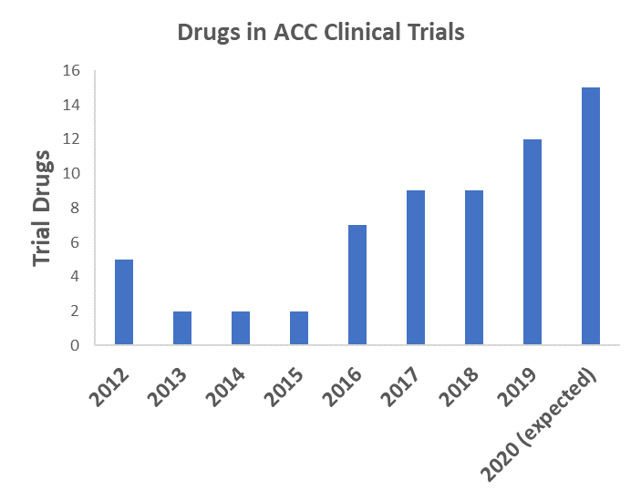
Clinical Trials for ACC Patients

Slide 13
Impact of COVID-19
Basic Research
  Some labs in hotspots have shut down for 1-3 months
  Cell cultures and other valuable resources are being maintained
Preclinical Drug Screening
  No delay in ACCRF’s contract research studies
Clinical Trials
  Travel limitations impacting out-of-town patients, particularly for infused drugs (oral drugs may be shipped)
  Immune checkpoint inhibitors problematic due to COVID-19 symptom overlap
  Telemedicine is facilitating access and will likely persist in the future

